Slide 1
16.216
ECE Application Programming
Instructor: Dr. Michael Geiger
Fall 2013
Lecture 13:
Exam 1 Review

Slide 2
Lecture outline
Announcements/reminders
  Program 3 regrades due today
    Regrades have deadlines—late penalties will apply!
  Program 4 due 10/7
  Early feedback forms Monday
Today’s class: Exam 1 Review
  Exam stats
  Regrade requests
  Solution
ECE Application Programming: Exam 1 Review

Slide 3
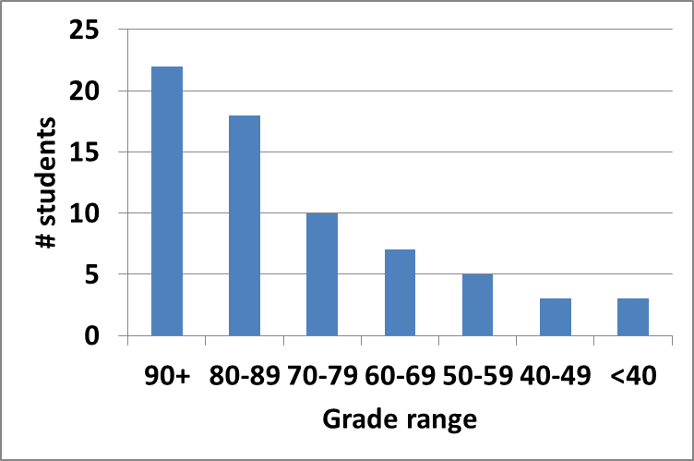
Exam stats & grade distribution
Average: 77.4
Median: 84
Std. deviation: 18.9
Max: 97 (x2)
Question-by-question averages:
  Q1: 16.1 / 20 (81%)
  Q2: 31.1 / 40 (78%)
  Q3: 30.2 / 40 (75%)
Extra credit
  47 students completed
  6.3 average
ECE Application Programming: Exam 1 Review

Slide 4
Regrade requests
Due 10/11
Must be written
You must also return your exam
  Do not write on your exam if you plan on submitting a regrade request
Must demonstrate understanding of problem
  Bad: “I deserve more points on Problem 2a.”
  Good: “I deserve more points on Problem 2a because I calculated a wrong value for f based on an incorrect value for x. I used the right formula; I just plugged in the wrong value.”
ECE Application Programming: Exam 1 Review

Slide 5
Next time
Functions
Early feedback form
Reminders:
  Program 3 regrades due today
    Regrades have deadlines—late penalties will apply!
  Program 4 due 10/7
  Early feedback forms Monday
ECE Application Programming: Exam 1 Review

